Slide 1


DREAM 11
BUAN 6320 BY PROF. GASAN ELKHODARI

Slide 2

DREAM 11
By:-
Akshay Ochani, Neha Jaladi, Vansh Pathria, Ajay Prathap, Vaishnavi Vinta
Master of Science in Information Technology and Management

Slide 3
Overview
DREAM 11
Dream 11 is a fantasy sports app where you can create your fantasy team based on real-life matches. Join contests and win daily cash prizes.
Notes:
How It works?
Once you register on Dream11, you will come across a lot of matches. You are supposed to select which match you wish to play and then create a team of 5 players before the match begins.
Pay the entry fee and you will join the contest with other participants who will compete with you with their virtual teams.
Once the match starts, players in your team will be awarded points as per their performance and if your team scores the highest you win. Simple as that.

Slide 4
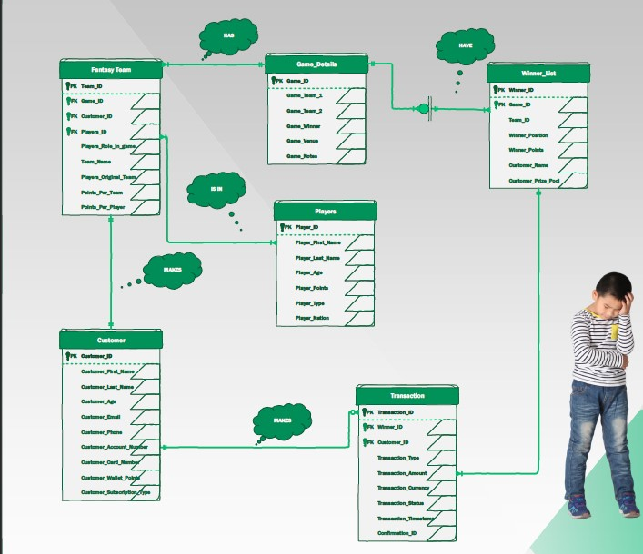
ERD
DREAM 11
Notes:
A Customer makes none to many Transactions
A Transaction must be made by one Customer
A Customer must choose a Fantasy Team
A Fantasy Team will be chosen by the Customer
A Fantasy team must have one Game Detail
Game Detail will be having one or many Fantasy Teams
Fantasy Team will have one or many Players
Either one or many Players are in a Fantasy team
Game Details will have many Winners
Winner list will be assigned to a single Game

Slide 5
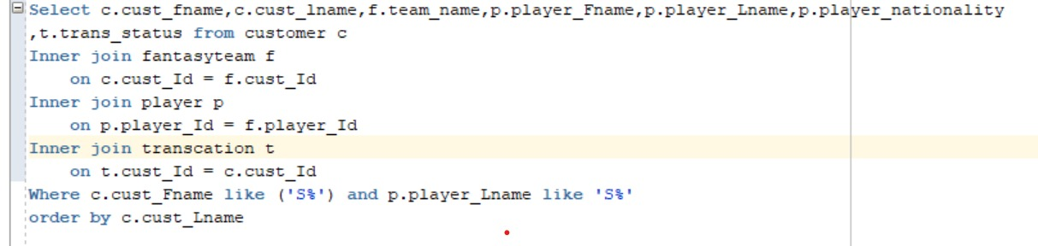
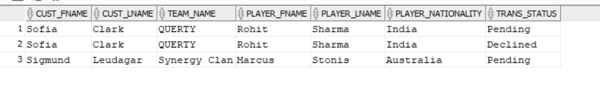
COMPLEX QUERY
DREAM 11
Query to display the details of customer first name starting with 'S', and player selected by the customer whose last name starts with 'S'. Also display customer transaction status and sort the result using customer's last name.
Result:

Slide 6
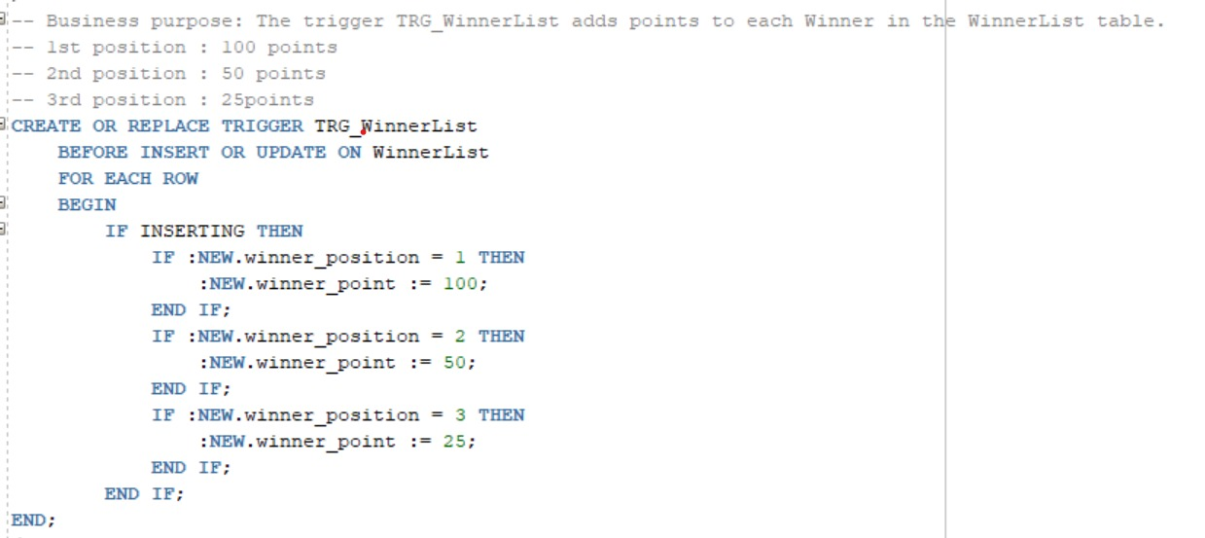
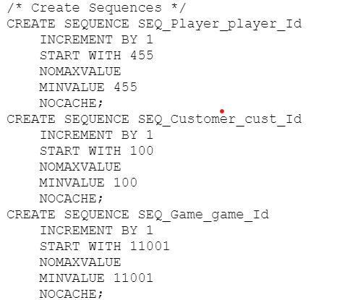
TRIGGER & SEQUENCE
DREAM 11
Notes:
IMPLEMENTATION:
Incorporated triggers to add the points for each customer and the winners.
The trigger TRG_WinnerList adds points to each Winner in the Winner List table. -- 1st position : 100 points -- 2nd position : 50 points -- 3rd position : 25points
The trigger TRG_Customer adds 10 points to each newly inserted row or updated record in the customer table.

Slide 7
CHALLENGE WE FACED!
DREAM 11
Dream 11 was a complex project but not impossible! We found automating of proper points being rewarded to the respective winners to be the most challenging!
To overcome this challenge we brainstormed as a team and we overcame that by implementing a trigger which rewards respective winners automatically.

Slide 8
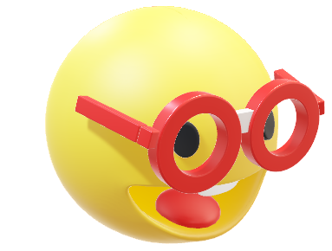
Questions?

Slide 9

Contact information:
Akshaynaresh.Ochani@utdallas.edu
Neha.Jaladi@utdallas.edu
Vansh.Pathria@utdallas.edu
Ajay.Prathap@utdallas.edu
Srivaishnavi.Vinta@utdallas.edu
Thank you

